Slide 1
INTELLISCANAI agent
IBM AICTE PROJECT
Presented By:
Student name : SHANMUGESHWARA A
College Name & Department :
K.S. RANGASAMY COLLEGE OF TECHNOLOGY &
COMPUTER SCIENCE AND ENGINEERING

Slide 2
OUTLINE
Problem Statement
Technology used
IBM cloud services
Wow factor
End users
Result
Conclusion
Future scope
IBM Certifications
Github link

Slide 3
Problem Statement
Academic institutions are facing increasing challenges in identifying advanced forms of plagiarism in student assignments, particularly when content is paraphrased or generated using AI tools. Existing plagiarism checkers fail to detect subtle inconsistencies and lack contextual understanding of instructor-specific feedback and grading patterns.
Proposed Solution: An AI-powered plagiarism detection agent that:
Analyzes historical assignment submissions and instructor feedback
Detects inconsistencies, content style deviations, and suspicious AI-generated responses
Flags content based on context, originality, and instructor-defined standards
Enhances academic integrity with improved detection accuracy

Slide 4
Technology used
IBM cloud lite services
IBM Watsonx AI Studio
IBM Watsonx AI Runtime
IBM Granite foundation model
Natural Language Processing (NLP)
Contextual Similarity Detection Algorithms
Learning from instructor feedback and assignment history

Slide 5
IBM cloud services used
IBM Cloud Watsonx AI Studio
IBM Cloud Watsonx AI Runtime
IBM Cloud Agent Lab
IBM Granite foundation model

Slide 6
Wow factors
Learns instructor-specific writing and grading patterns
Identifies paraphrased or AI-generated content with high accuracy
Flags style inconsistencies and academic misconduct dynamically
Provides context-aware plagiarism reports to faculty
Supports multiple assignment formats: essays, code, presentations
Enhances academic integrity without false positives
Reduces manual effort in assignment validation and review

Slide 7
End users
Faculty and academic staff
Students submitting assignments
Educational institutions and universities
Research evaluators and academic committees

Slide 8
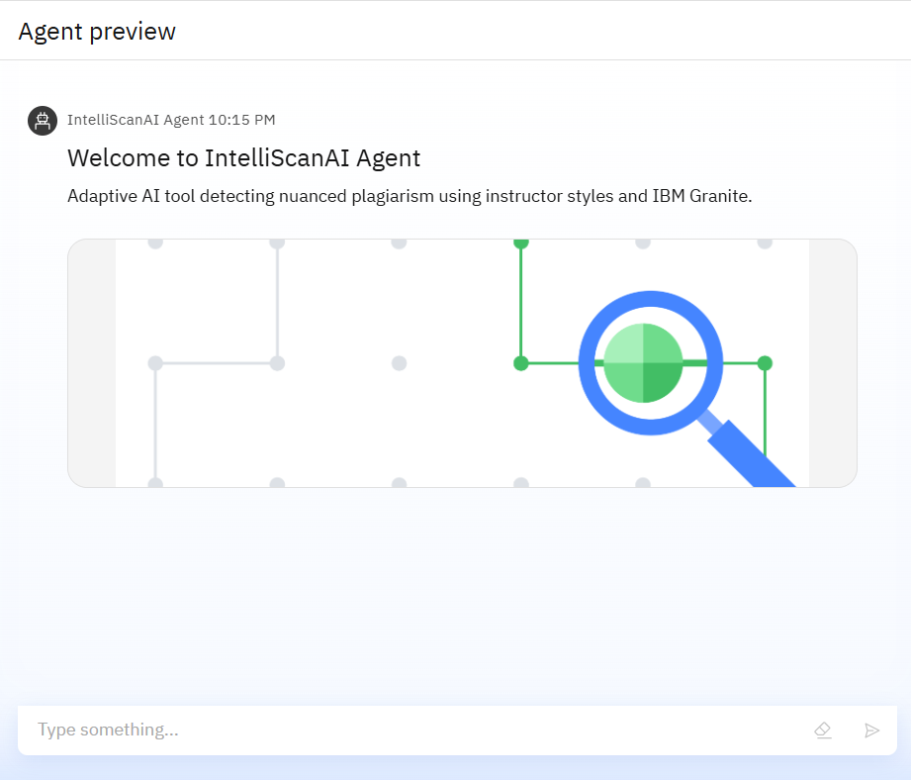
Results

Slide 9
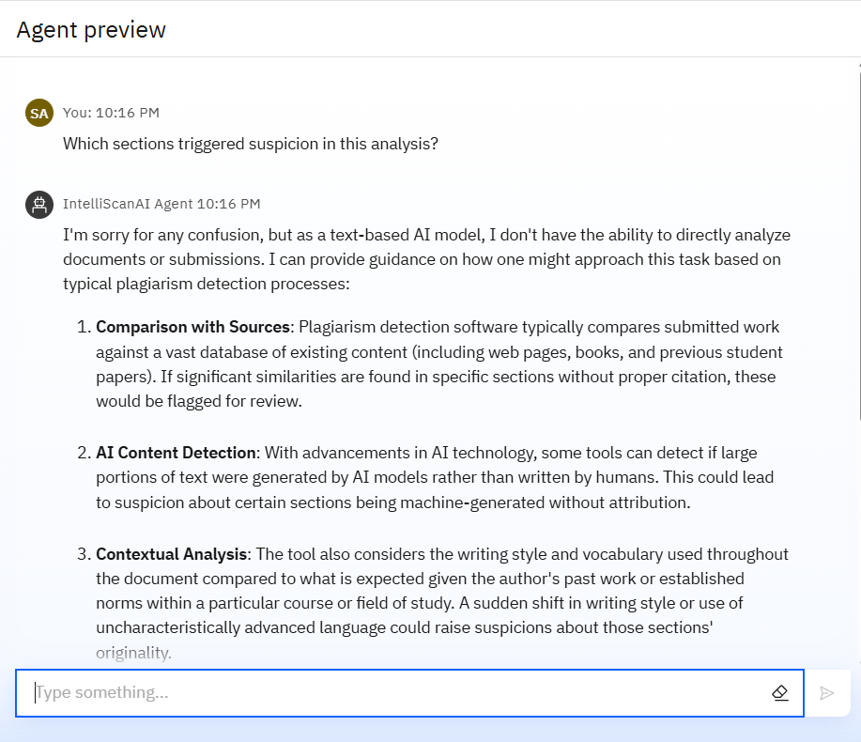
Results

Slide 10
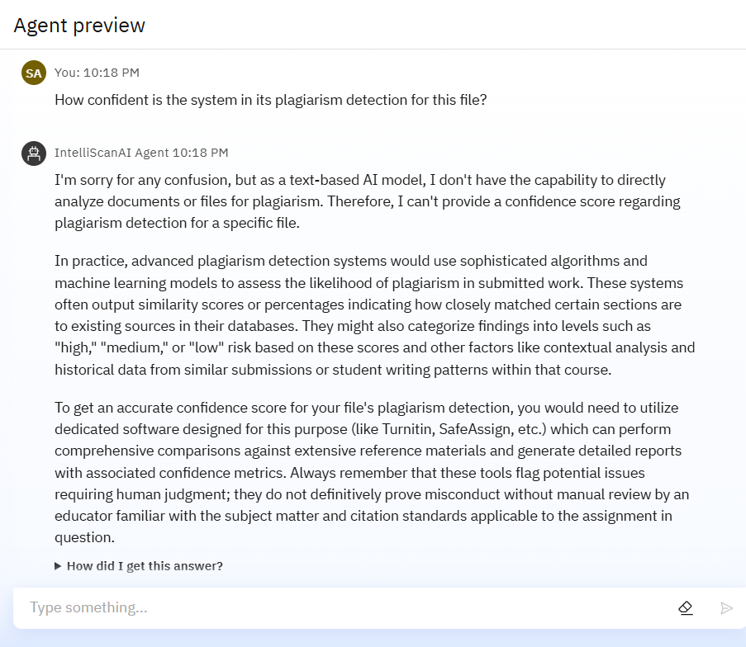
Results

Slide 11
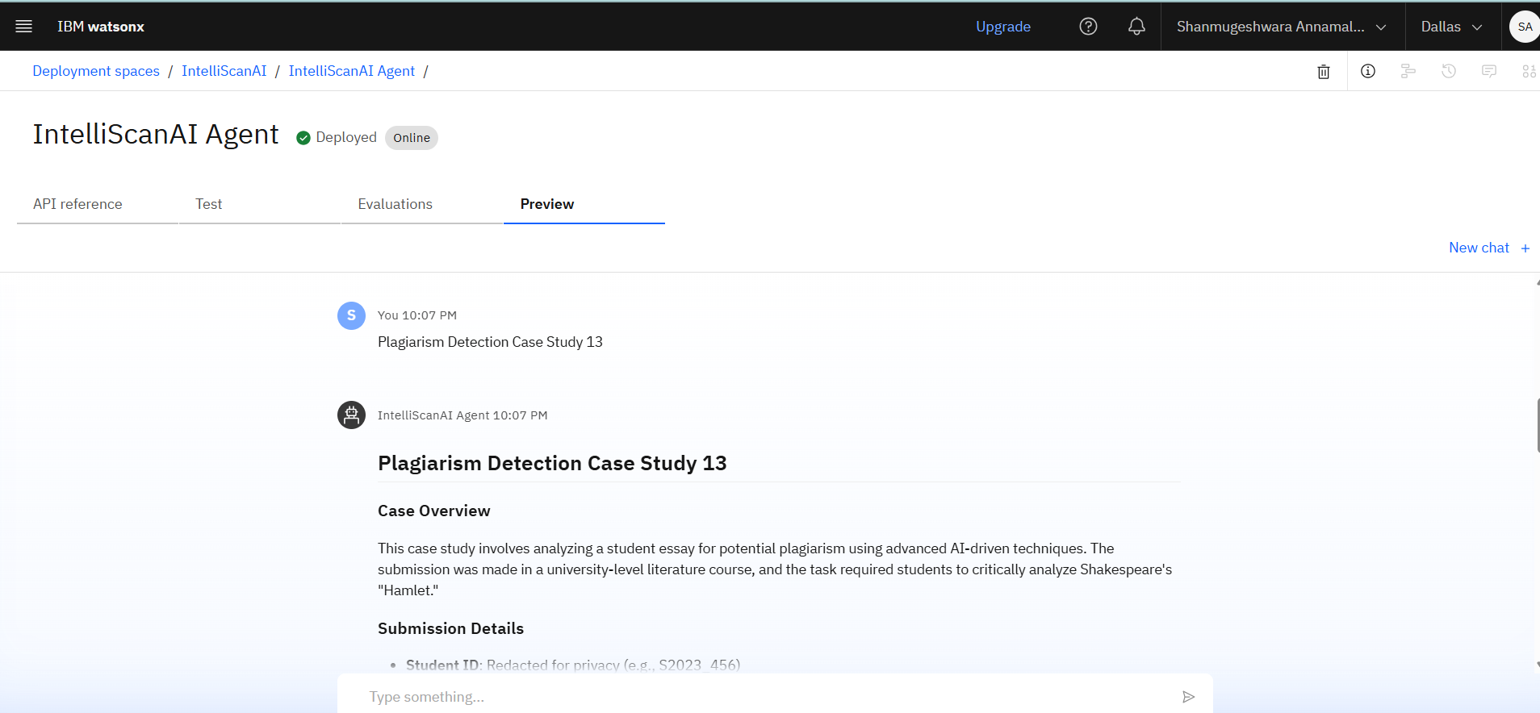
Results
Deployed AI Agent

Slide 12
Conclusion
AI agent offers scalable and accessible fitness solutions
The AI agent addresses modern plagiarism detection gaps
Promotes academic honesty and integrity
Uses adaptive learning for institution-specific tuning
Offers a scalable and smart academic integrity solution

Slide 13
Voice-based interaction for accessibility
Future scope
Integration with LMS platforms (e.g., Moodle, Canvas)
Detection of AI-assisted coding plagiarism in programming tasks
Multilingual support for international institutions
Voice/audio transcription plagiarism detection
Real-time feedback to students during submission
Instructor dashboard with detailed reports and analytics

Slide 14
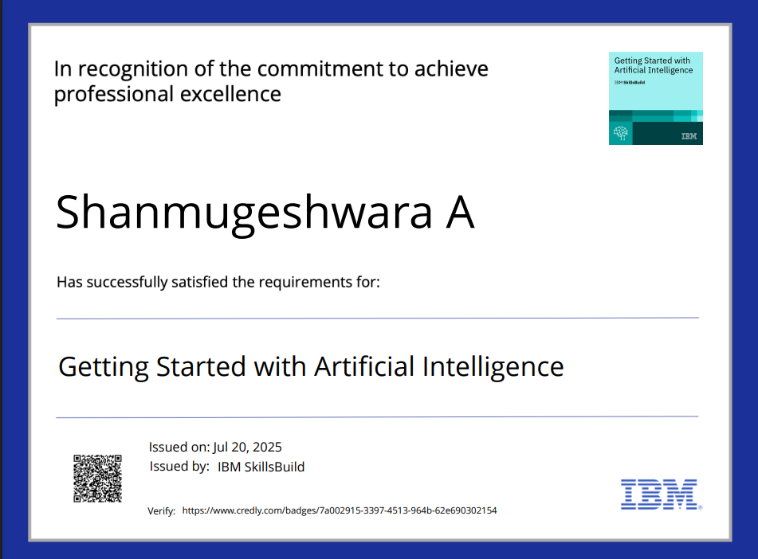
IBM Certifications

Slide 15
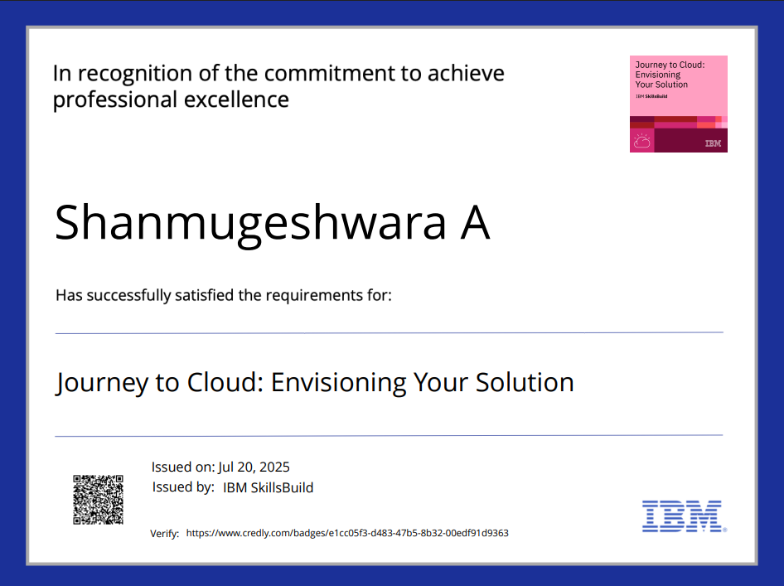

Slide 16
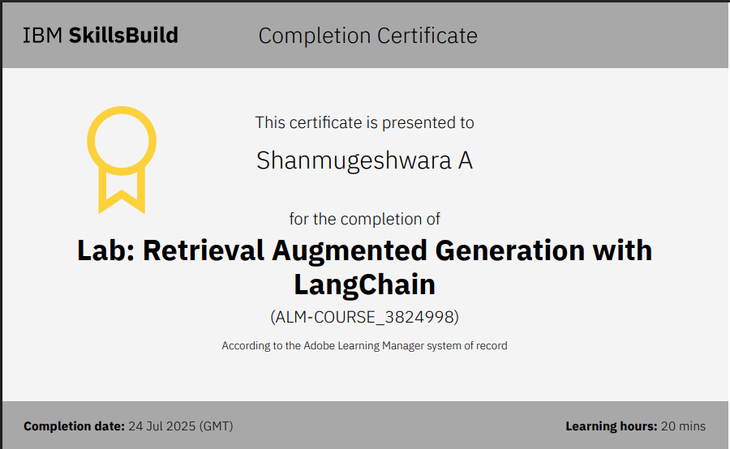

Slide 17
GitHub Link
GITHUB LINK : https://github.com/shan1201/IntelliScanAI-Agent-IBM-AICTE-/upload

Slide 18
THANK YOU

